Slide 1
FPGA Design EECE 277-01 VGA Signal Generation
Dr. William H. Robinson
October 20, 2014
http://www.vuse.vanderbilt.edu/~robinswh/

Slide 2
DE2 Board Pin Assignments
Your pin assignments must correspond to the DE2 board specifications
Download the Altera DE2 Board Pin Assignments from Blackboard
Go to “Assignments → Import Assignments”
Import the Comma Separated Values file
Verify by viewing the Assignment Editor
You do not have to make each pin assignment manually when using VHDL
Quartus II will match pin names to the ports of the top entity of your design if you use the same names
On OAK under Lab 3, there is a file (DE2-115 Top) that contains an entity declaration with all the pins

Slide 3
Video Graphic Array (VGA)
Resolution: 640 x 480
Display: 16 colors (4 bits), 256 colors (8 bits), 1024 colors (10 bits)
Refresh Rate: 25 Hz, 30 Hz (frames / second)
RGB: Red, Green and Blue colors
Monitor technology: Cathode Ray Tube (CRT)
Adapted from Kris Gaj’s ECE 448 lecture notes. Copyright © 2007 GMU.

Slide 4
VGA Monitor
0
639
0
Horizontal Flyback
Horizontal Trace
Vertical Flyback
479
Adapted from Kris Gaj’s ECE 448 lecture notes. Copyright © 2007 GMU.

Slide 5
DAC VGA Monitor Interface

Slide 6
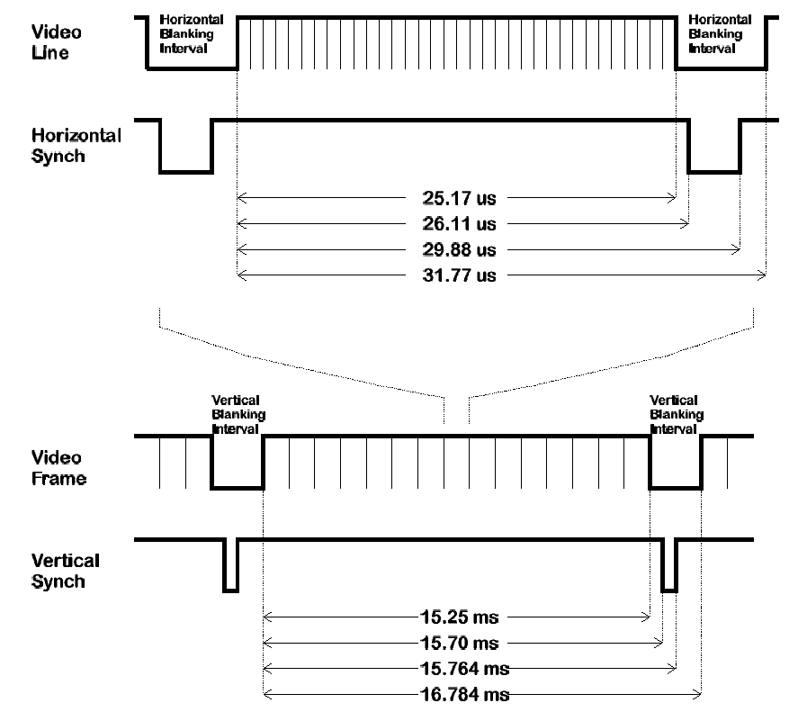
VGA Control Signal Timing
Resolution
640 x 480
Adapted from Kris Gaj’s ECE 448 lecture notes. Copyright © 2007 GMU.

Slide 7
VGA Control Signal Timing (f_{CLK} = 50 MHz)
1258 clock cycles
1305 clock cycles
1494 clock cycles
1588 clock cycles
480 lines
494 lines
496 lines
528 lines
Adapted from Kris Gaj’s ECE 448 lecture notes. Copyright © 2007 GMU.

Slide 8
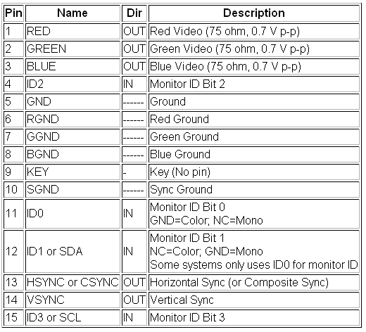
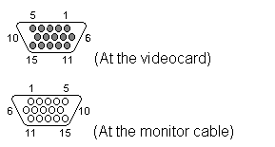
VGA 15 Pin
Adapted from Kris Gaj’s ECE 448 lecture notes. Copyright © 2007 GMU.

Slide 9
VGA Sync Module
Figure 10.9 Display and Compute clock cycles available in a single Video Frame.
Rapid Prototyping of Digital Systems Quartus II Edition: Chapter 10
Copyright © 2006 Springer

